Slide 1


Solution By: Synergy
Theme : Medical & Community Healthcare
Project Title: Health-e-AI

Slide 2

PROBLEM STATEMENT
Due to very costly charges of hospitals and other medical facilities like ICU ,bed charge, ventilation and many other charges many people are unable to get proper treatment.
And even if they have money it is not an easy task to monitor the patient constantly and predict the condition of severe diseases like heart attack, cancer, diabetes, pneumonia etc.

Slide 3

Idea Introduction
IDEA INTRODUCTION
The basic objective of the idea is to measure patient health parameters such as body temperature, heart rate (BPM), blood oxygen levels (Sp02) through a wearable device and send it to a cloud platform so that it can be monitor from any device (like Smartphone, PC, Laptop, Smart TV,.) that support browsing capabilities.
The device is IoT enabled and can send the alert to the doctor and call ambulance when needed so that the medical help can be provided at time.
Artificial intelligence algorithm is then applied to the collected data to analyze the condition of patient so that necessary action can be taken at time. It is also able to predict heart attack, pneumonia, malaria, cancer and other major diseases so that required action can be taken.
IDEA TITLE :- Health-e-AI
Tech Stack
TensorFlow
Flask
Blynk
Thingspeak
Resources Used
ESP8266
GPS Module
IFTTT
Various sensors

Slide 4


Approach Towards Idea
Approach in Brief below
It consist of a device which uses ESP8266 webserver to track patient health status by measuring the parameters like body temperature, heart rate (BPM), blood oxygen levels (Sp02) through a wearable device and send it to a cloud platform so that it can be monitor from any device like Smartphone, PC, Laptop, Smart TV that support browsing capabilities
Additionally it has a panic alarm that will alert and notifies with location in emergency situation so that ambulance can be arrived at time and treatment can be provided to the patient.
It also monitors the temperature & humidity of patient’s surroundings.
Finally a web application is provided to doctor to analyse the health condition of patient through AI models which predict diseases like Cancer, Diabetes, Heart, liver, Kidney, Malaria and pneumonia with over 95% accuracy.

Slide 5
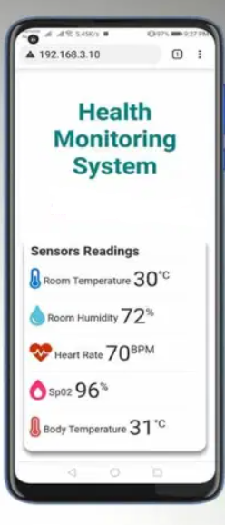
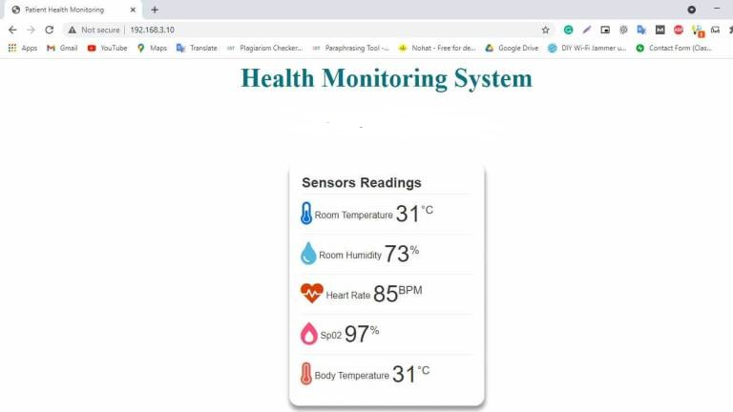
Web dashboard/APP

Slide 6
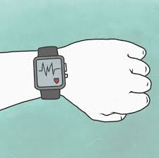




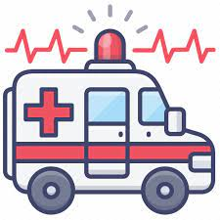

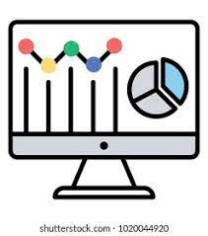

Health-e-AI : WORKFLOW
Applying AI to predict diseases
Send data to cloud
Emergency feature to call ambulance in panic situation by GPS location
Displaying data on App
Web app for doctor to analyze patient using AI

Slide 7
How it will benefit society
It will remove the dependencies on the medical staff for testing.
It will cutoff the cost of testing and equipment need.
It will help the poor and helpless people with the normal medical checkup.
It help people avoid paying huge amount to the doctors unnecessarily like bed charge and other medical facilities.
It can predict the health of patient using artificial intelligence accurately.
It can monitor the health of patient and call the ambulance whenever require so that live can saved.

Slide 8


Submitted by
RAVI TIWARI
ravi27101999@gmail.com

